Slide 1

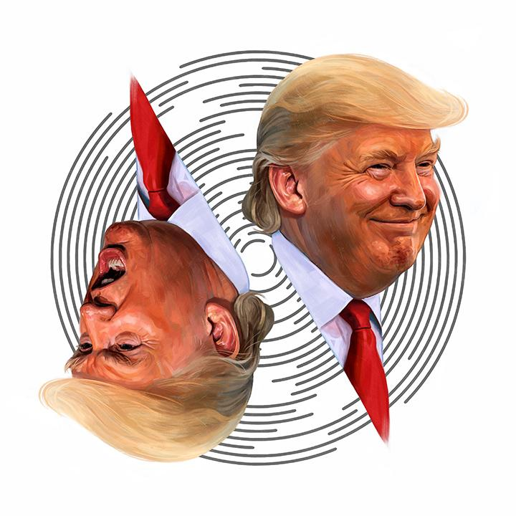
Trump’s tweets v. the S&P500
Group 7: Jared Madris, jenny yi, Nathan Mace, Stephanie ROman

Slide 2
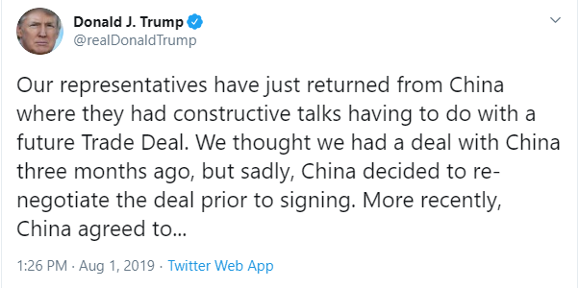
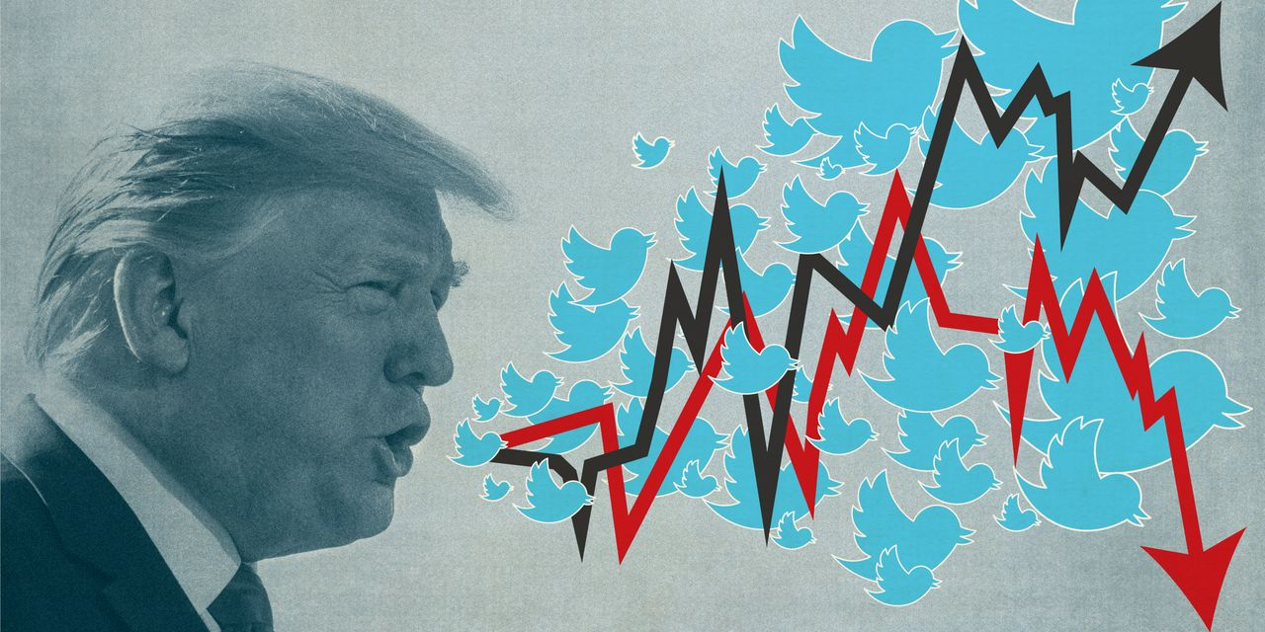
RESEARCH background
CONTEXT
In August 2019, Trump posted a series of tweets starting his plan to 10% tariffs on $300 billion worth of imports from China, in addition to the $250 billion already subject to levies. The S&P 500 fell 0.9% that same day and tumbled almost 3% the following Monday.
QUESTIONS
Do Trump’s tweets really move the markets? Using machine learning, can we build and train a model to determine the relationship between Trump’s tweets vs. S&P 500 movements?

Slide 3

RESEARCH APPROACH
ETL Trump’s Tweet Data
ETL S&P 500 Intraday Data
Add NLP Sentiment Analysis to Trump’s Tweets
Calculate Volatility of S&P 500 Prices
Merge 2 Datasets
Feed it into our Model
See What Correlates
Profit

Slide 4
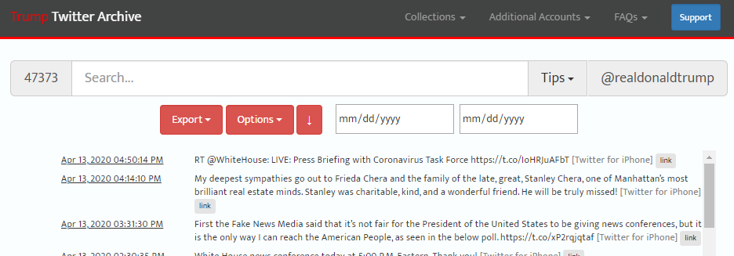
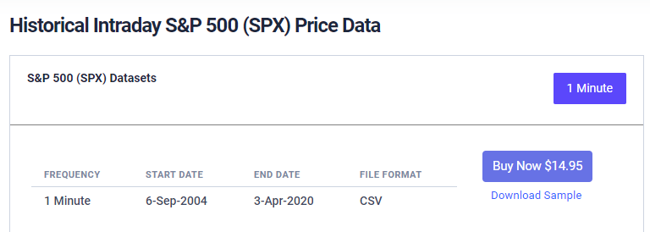
Data sources
1. http://www.trumptwitterarchive.com/archive
2. https://firstratedata.com/i/index/SPX
Notes:
Those >50YO are more likely to dislike rigid fabric and wide leg.

Slide 5
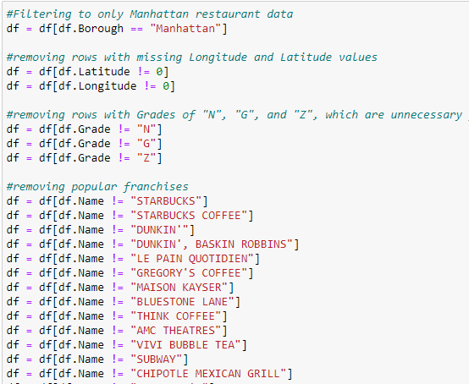
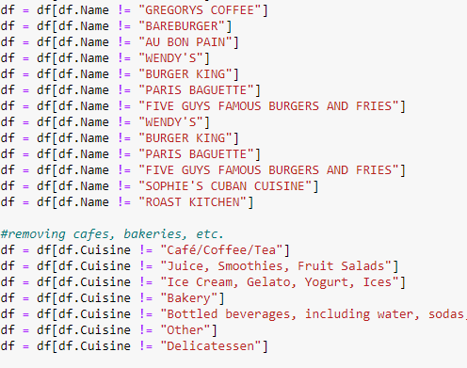
Data ETL
XX.

Slide 6
Data exploration
XX.

Slide 7
Analysis
XX.

Slide 8
Let’s check out the front end

Slide 9
conclusion

Slide 10
Questions?

Slide 11
Thank you!

